Slide 1
Summer Training Project Website - Green Nursery Prepared at SDTC
Aatish – cse/16-002
SATYUG darshan institute of engineering and technology

Slide 2
Programming Concept Used
HTML
CSS

Slide 3
OPTIONS THAT YOU CAN CHOOSE
HOME
ABOUT US
NURSERY GALLERY
LANDSCAPE
GARDEN ACCESSORIES
CONTACT US

Slide 4
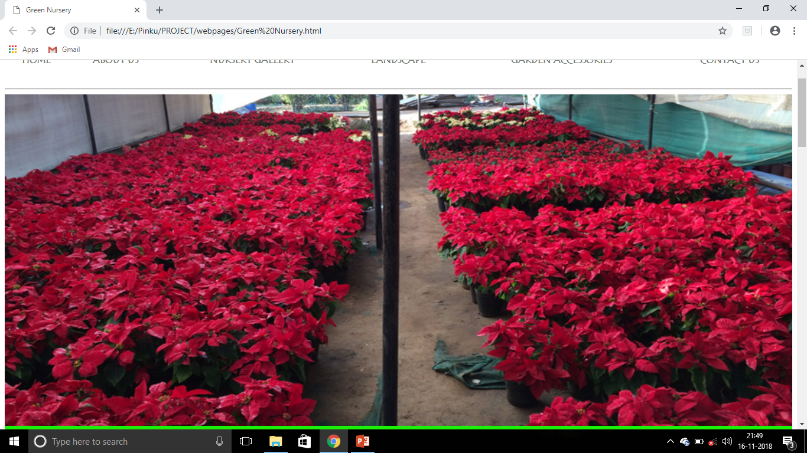
HOME PAGE
Here you can explore varies options and services provided by Green Nursery and its Staff.

Slide 5
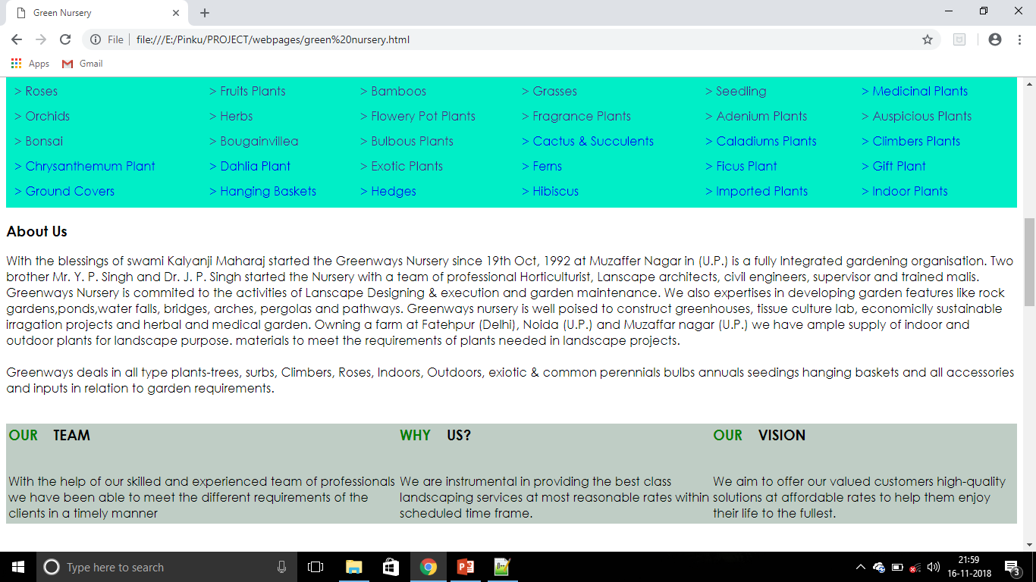

Slide 6
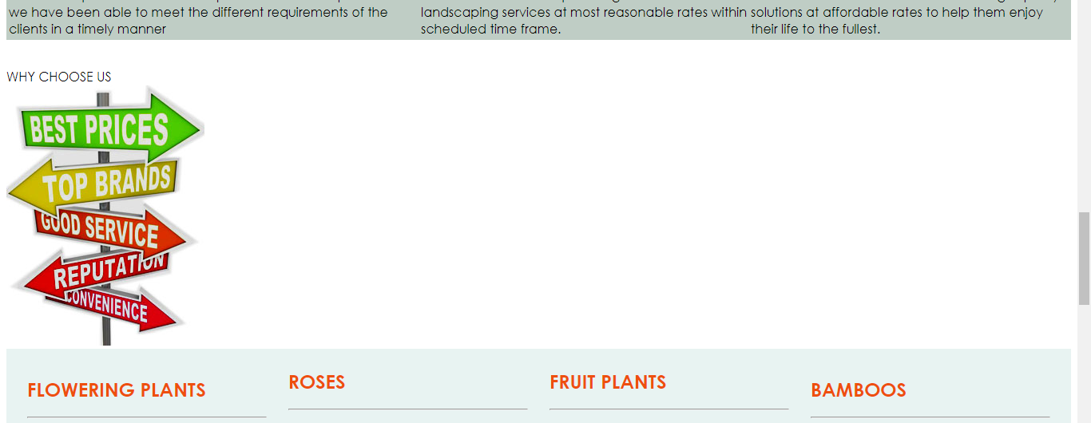
HOME PAGE

Slide 7
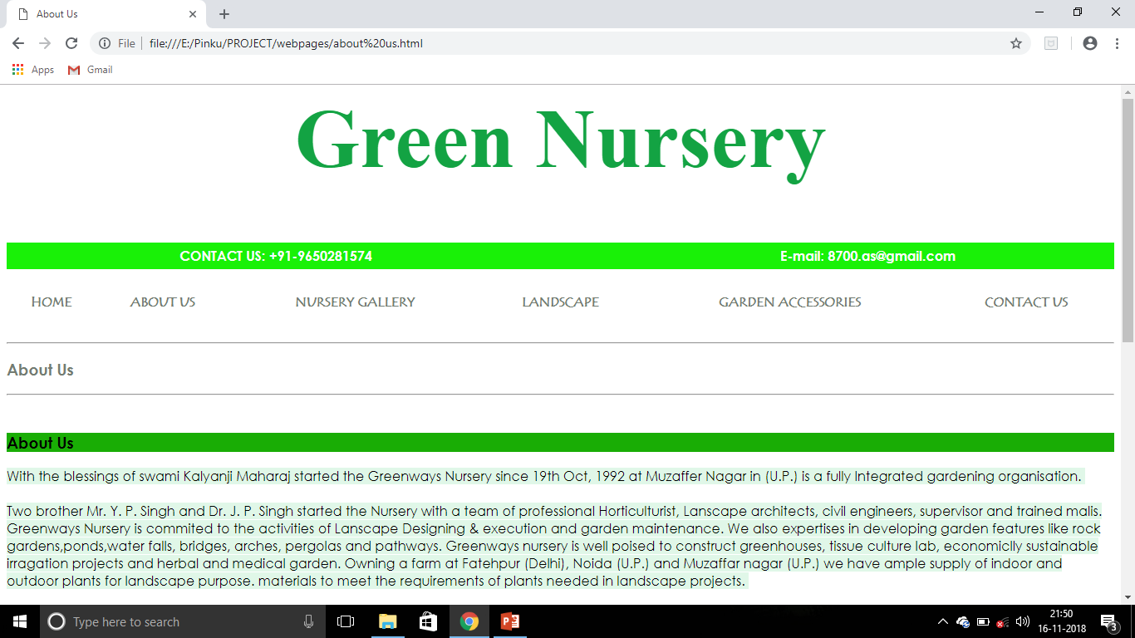
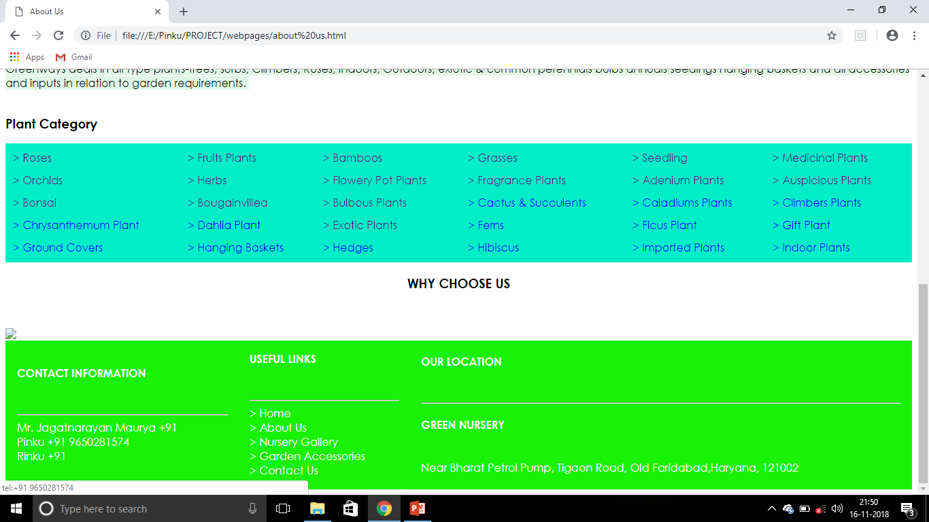
ABOUT US PAGE

Slide 8
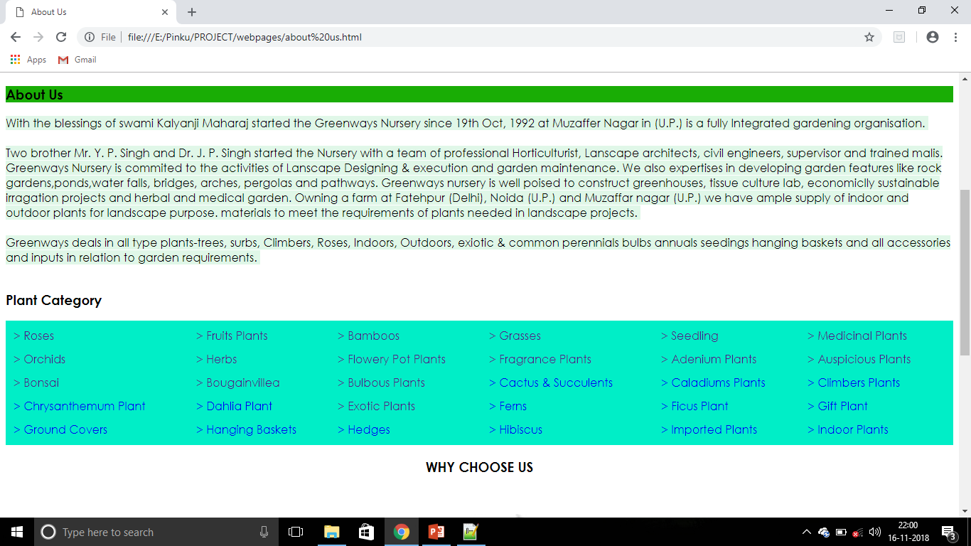

Slide 9
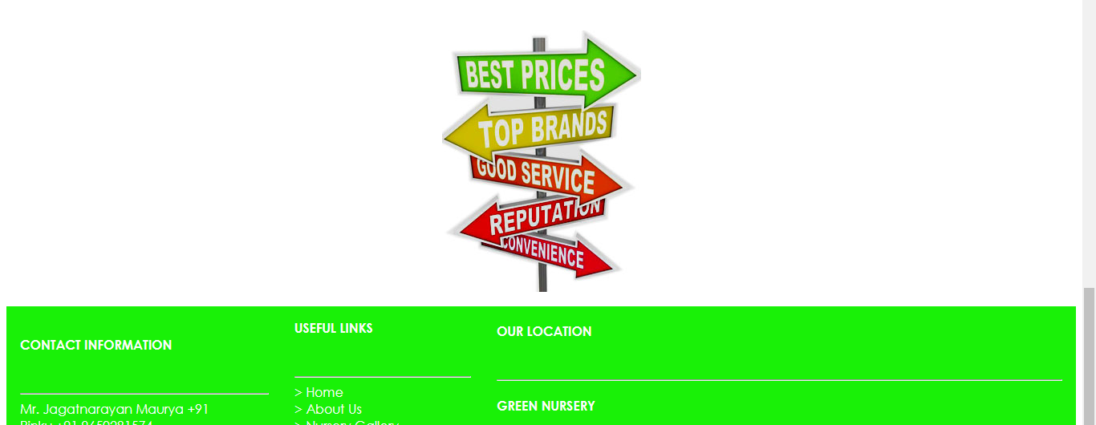
ABOUT US PAGE

Slide 10
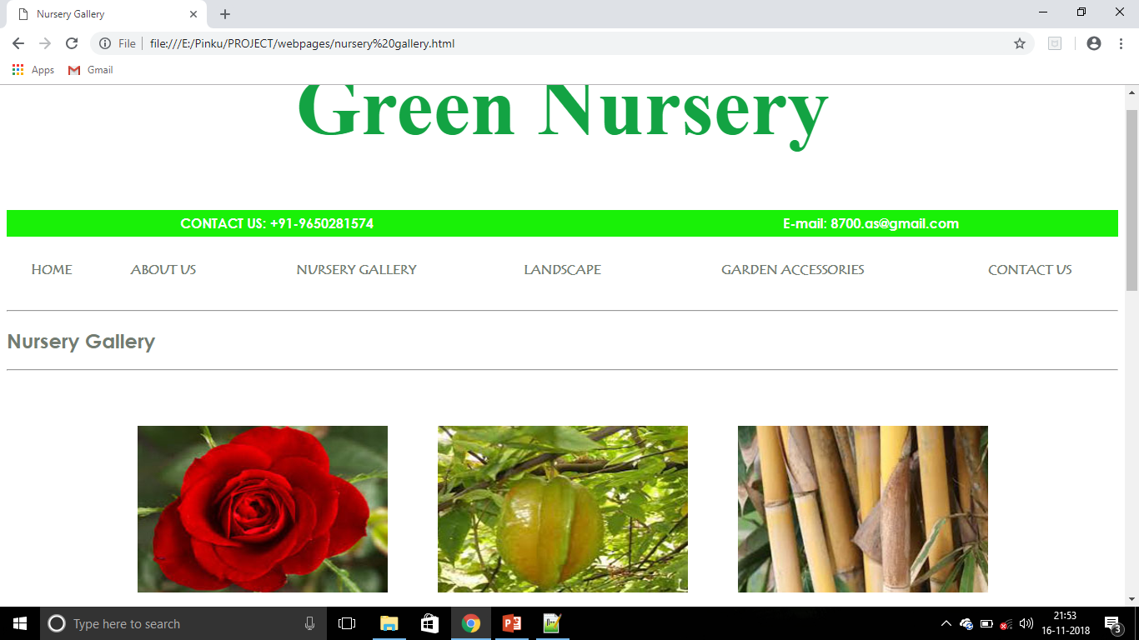
NURSERY GALLERY PAGE

Slide 11
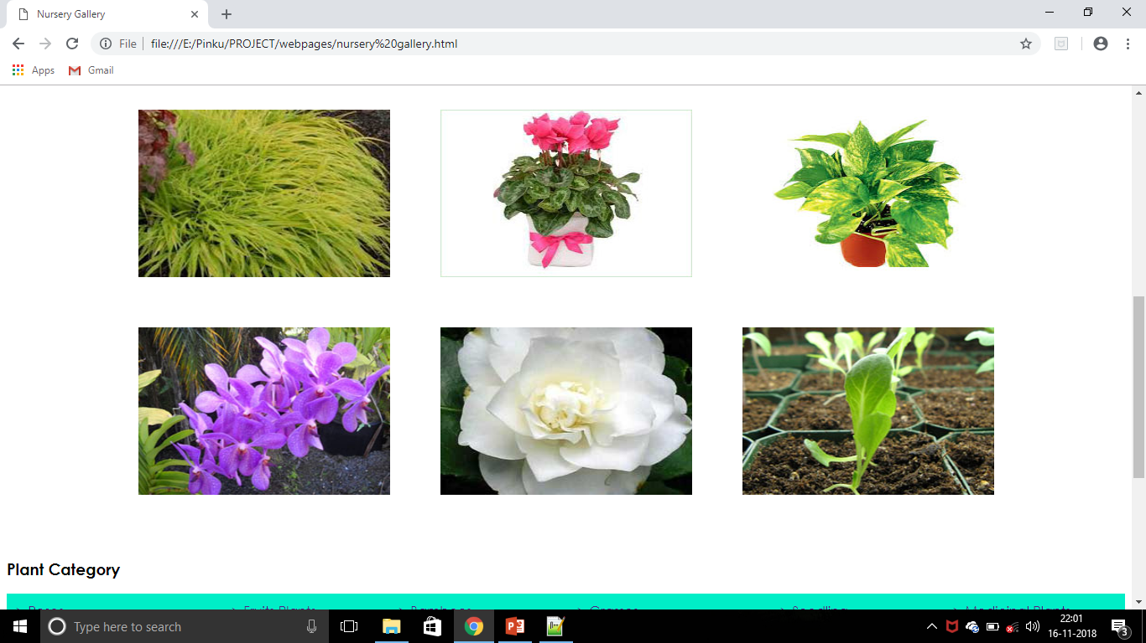

Slide 12
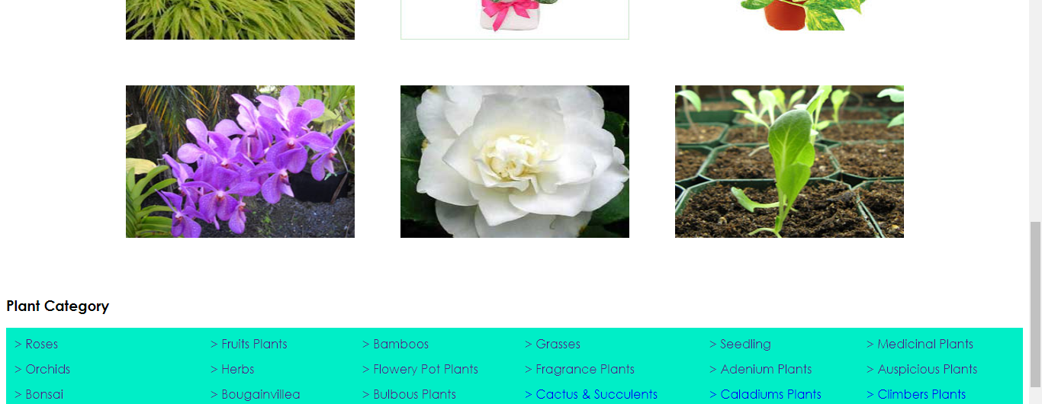
NURSERY GALLERY PAGE

Slide 13
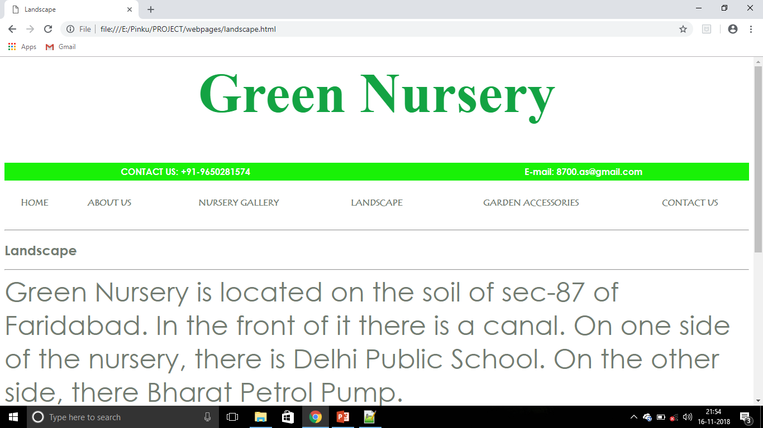
LANDSCAPE PAGE

Slide 14
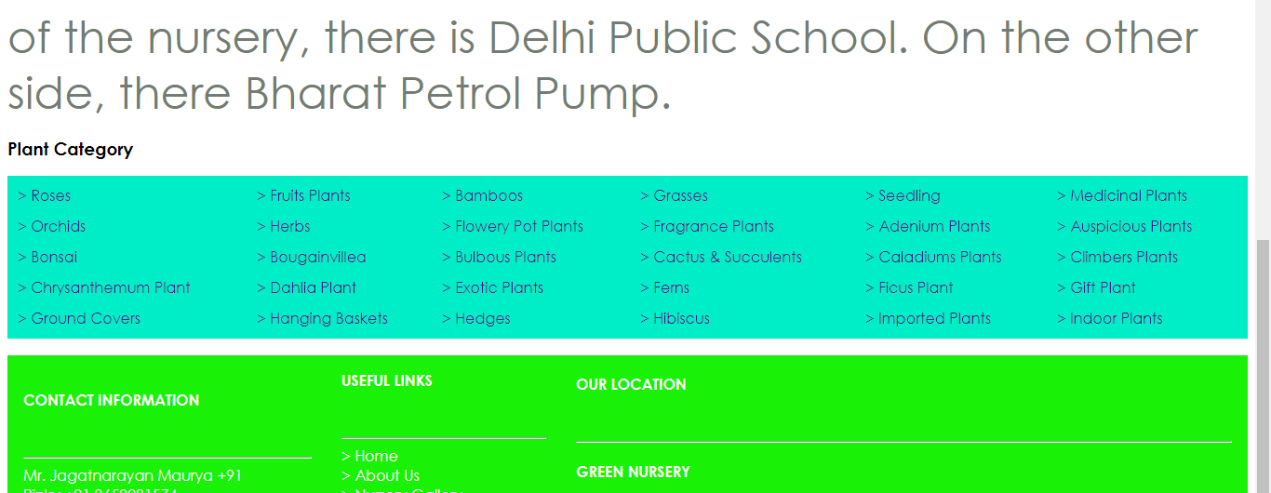
LANDSCAPE PAGE

Slide 15
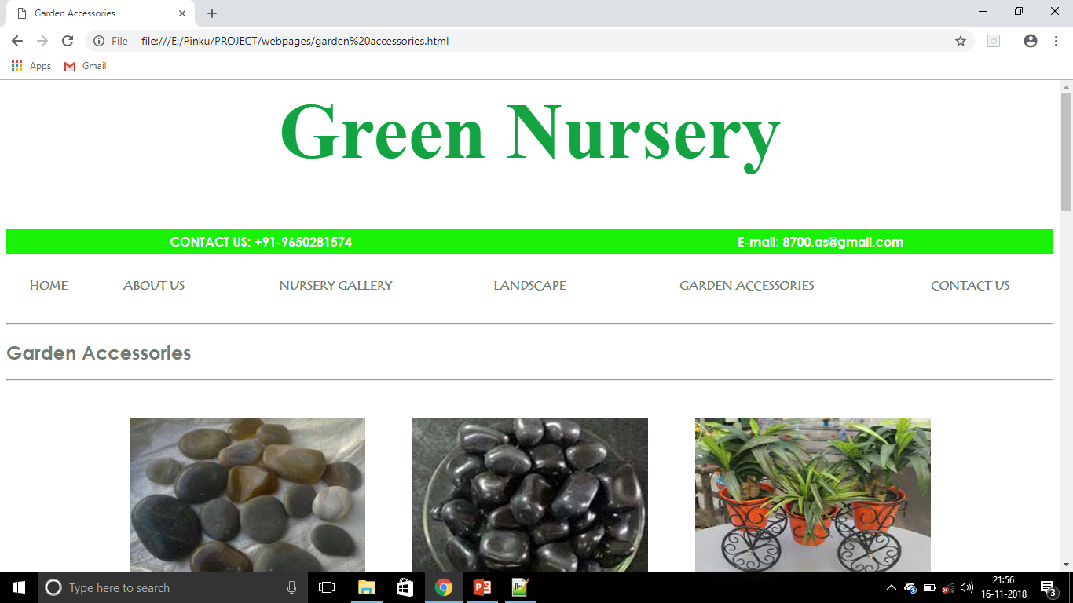
GARDEN ACCESSORIES PAGE

Slide 16
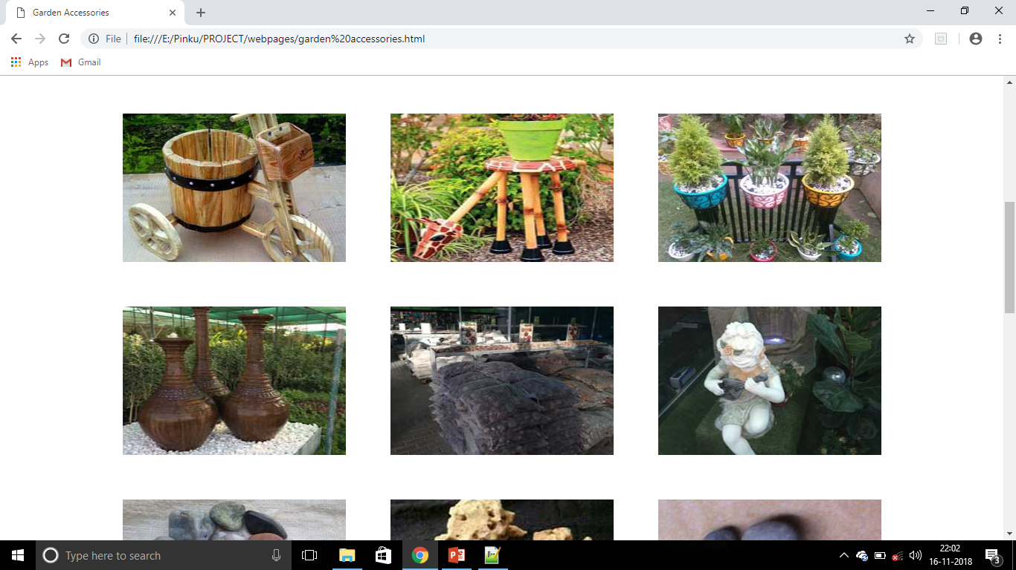

Slide 17
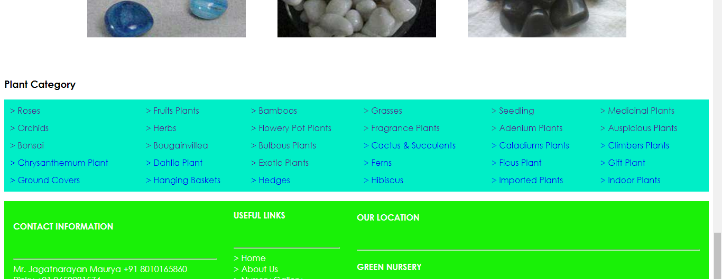
GARDEN ACCESSORIES PAGE

Slide 18
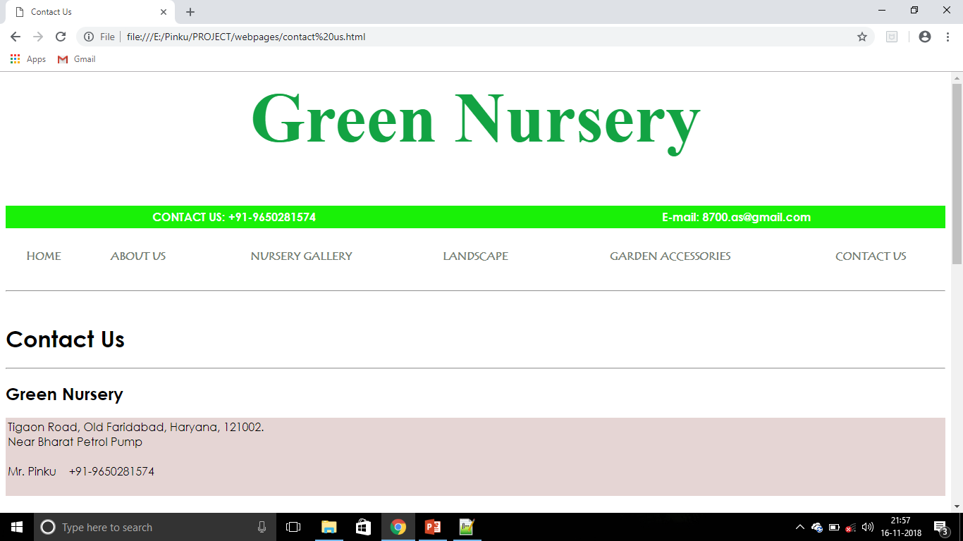
CONTACT US PAGE

Slide 19
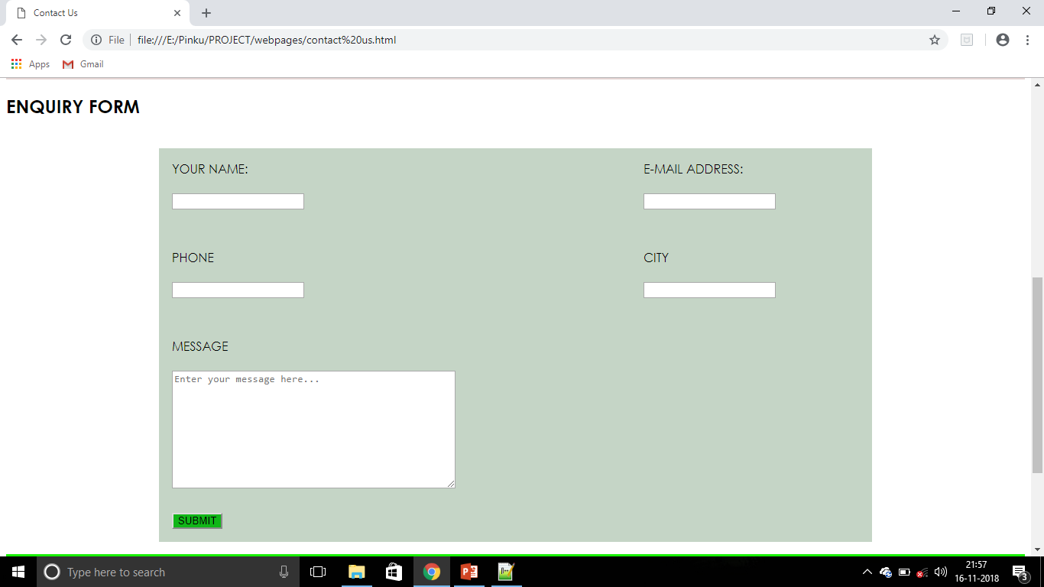
ENQUIRY FORM

Slide 20
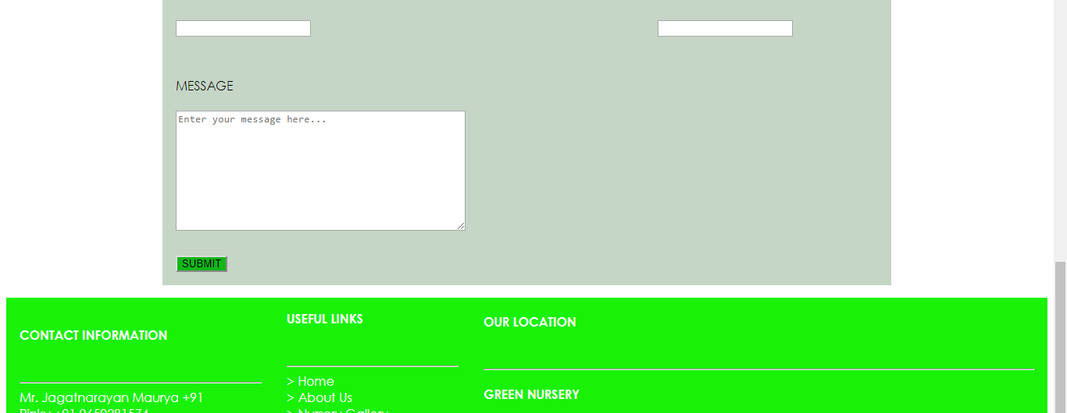
CONTACT US PAGE

Slide 21

BOTTOM MENU BAR

Slide 22
THANK YOU
HOPE YOU LIKED IT.

